Slide 1

LaunchCode Liftoff
Class 4
Kevin Beashore
1/6/2022
Slides adapted from: Hank Dedona

Slide 2
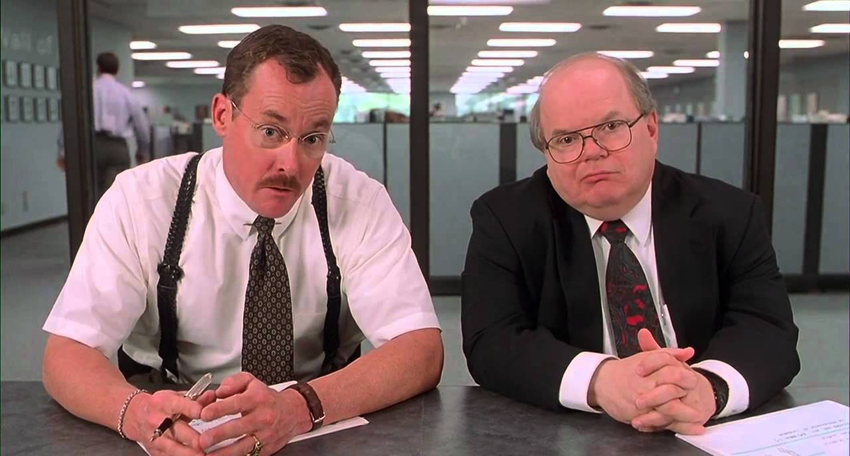
Agenda & Objectives
Code Reviews
Know how to give and receive good feedback
Live Coding
Activities & Assignment

Slide 3
Liftoff Project Timeline
User Stories & Trello
Git, Licensing, & Online Profiles
Class 1
Class 3
Class 2
Class 4
Wireframes & Project Outline (MVP)
Project Review 1
Notes:
Aggressive goals so we can provide as much direction as possible
Weekly progress
Something to review by Week 4
Break week
THIS IS THE YOU ARE HERE SLIDE!

Slide 4
Liftoff Project Timeline
Address Feedback & Technical Questions
Next Features & Interviewing
Class 5
Class 7
Class 6
Class 8
Next Features & Mock Interviews
Final Review
Notes:
More open format towards the end, start adding features
Final project review - May not be complete, but a good start

Slide 5
Code Reviews

Slide 6
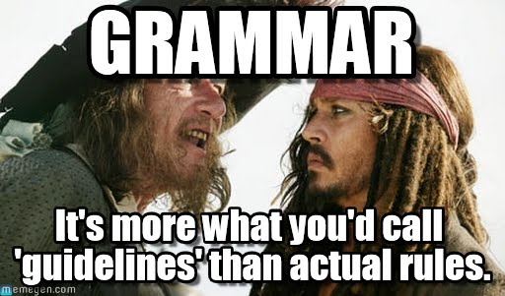
Clean Code Best Practices
Remove Dead Code
Clear Method & Variable Names
Encapsulate Duplicated Logic (DRY)
Comments Explain Why Not How
Clear Commit Messages
Spacing and formatting helps
Note: Teams will usually have predefined formatting/spacing/naming
Notes:
Dead code is code that is not being used, or functional at all – it’s code that should not make it to a code review because why waste your team members time with code that is non functual.
By having clear Method and Variable names your code is easier to reason about and read. Saving team members review time and you future time when/if you have to come back and edit the code.
DRY stands for do not repeat yourself – basically ask yourself am I repeating myself in my code and can I create a method or function to call over having to repeat myself
Your code comments indicate what things are and why they exist over how
When commiting changes to your branch in PR, really when commiting in general, your commit message should indicate the changes made
Some teams have standards for formatting on branching, commiting, rebasing, etc with git when in doubt check with your team.

Slide 7
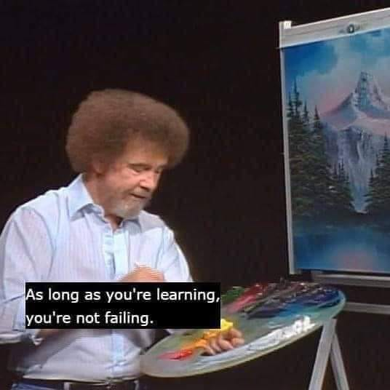
Addressing Feedback
A Code Review Is About The Code, Not You
Don’t take it personally!
Prioritize Changes
critical functional first
Redesign changes
Ask What Could Be Improved
Ask For Clarification and Explanation
Pair Up (pair programming)

Slide 8
Giving Feedback
We’re All Learning
Ask For Clarification
Avoid “you” statements (accusatory)
Provide Actionable Suggestions
Notes:
Sometime code review comments can come off as other engineers destroying your work when in reality it is to foster a learning environment for all team members on that review.
If you don’t understand something ask for Clarfication
Hey can someone explain what this code is doing here?
Why do we need a separate file or why is this design this way?
Try to not say “you” messed up here “you” should have done it this way … comes off accusatory
Provide suggestions for the code you are commenting and if you can why you think it should change
Hey this method named is confusing what about this new name which highlights what the method is actually doing.

Slide 9
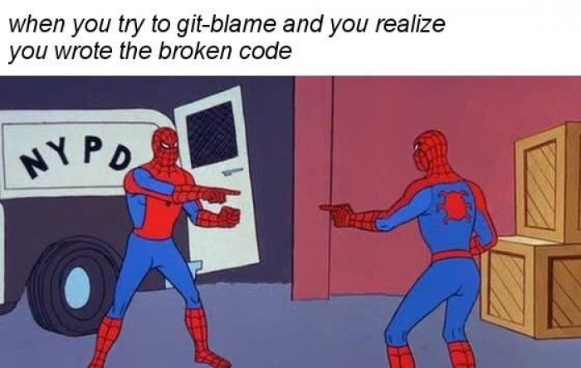
Some Lessons You Have To Learn The Hard Way
Notes:
The amount of times code breaks and I think what person wrote the code and why did they write it like this?? Then I check the git-blame, which is git’s way of tracking who made the last change to specific lines turns out it was me or someone I directly worked with is insane….
So insert blaming myself :D but hey we are all always learning

Slide 10
Preparing for Tech Interviews
Notes:
We have been answering coding questions every class period the reason for that is this

Slide 11
First things, first….Technical Interview
Thoroughly read through the job description
What tech stack do they use?
What skills are they looking for?
Do you meet MOST OF the requirements?
Research the company you are applying for
What is their mission statement, values, guiding principals, and culture?
What do they mean to you? Be able to talk about them?
Google “{company name} tech interview”
Do some practice hacker rank coding questions
Notes:
We can just remove technical here for a second and visit the interview part of this….
Read the job description
Tech stack – Is it the tech stack you want to work in? Is it a tech stack you have experience with?
Skills – What skills are they looking for? Do you have them can you cater your resume to that?
Requirements – note MOST OF here if you meet all the requirements for a job that is great but what are you going to learn in that job to grow?
Research the company you are applying for
People have recently applied to Boeing what is it’s mission statement?
“People working together as a global enterprise for aerospace industry leadership.”
Values
Start with engineering excellence.
Be accountable — from beginning to end.
Apply Lean principles
Eliminate traveled work. – to things right the first way to eliminate having to do it again.
Reward predictability and stability — everywhere in our business.
Lead on safety, quality, integrity and sustainability.
Principals
integrity, respect, accountability and inclusion
BEING ABLE TO TALK ABOUT THIS THINGS shows you are interested in the job over just saying you are (the action of spending time outside of the interview preparing indicates this)
Google things about the company use sites like LinkedIn, Indeed, Glassdoor, and Comparibly
Use your network!! I reached out to Derek about a job offer I have from his company to find out more about the company internally
OK END RANTABOUT INTERVIEWS IN GENERAL
Back to technical interviews.
Prep Work Example https://education.launchcode.org/liftoff/articles/technical-resume/
Kevin’s Resume: https://docs.google.com/document/d/13K55jmG-7qahdiEhwuwkKJtLhdZ48RcA/edit?usp=sharing

Slide 12
Live Coding

Slide 13
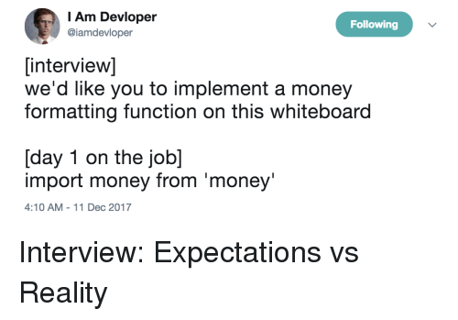
Live Coding - Introduction
Why
Live Coding Interview is Likely
Practice Live Coding Interviews
Many Approaches
Ask before the interview
In-Person / Online / take home
Whiteboard or Computer
IDE or Notepad
Can you Google?
Goals
Solve Problems
Collaborate

Slide 14
Live Coding - Goals
Interviewers are looking for candidates who...
...ask questions to fully understand the problem.
...work towards a correct solution.
...has an understanding of the language syntax.
...demonstrates how to test the solution.
...addresses any bugs.
...can communicate their thought process.

Slide 15

Live Coding - Process
Gather Requirements
Break Problem Down
Comments are your friend
Pseudocode
Write Syntax (sometimes)
Test & Make Changes
https://education.launchcode.org/liftoff/videos/live-coding/

Slide 16
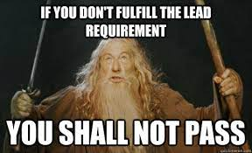
Gather Requirements
Ask Too Many Questions
Input/Output
Edge Cases/Validation
Write Out Requirements
Helpful Later
What will the data look like
Data structure?
Notes:
Understand that the technical questions are sometimes timed (outside of take home technical questions) ask all the questions you need to fully understand the questions
Ad
Ads
Remember how I said comments are your friend. Writing out requirements in comments and little notes about things while time consuming can help get your thought process across to the interviewer and help you stay to track later
As far as Data Structure think about how the data needs to be structured in order for you to loop over or work with.

Slide 17
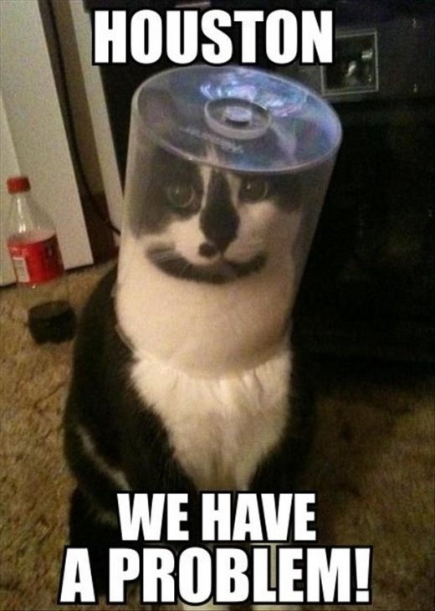
Break Problem Down
Restate The Key Points
Think out loud!
Rough Order Of Problems
Resist The Urge To Code
Stop, Turn Around, and Ask!

Slide 18
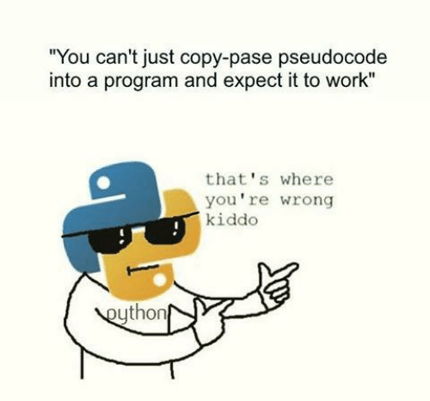
Pseudocode
No Code/Syntax
Still thinking out loud!
Focus On Control Structures
If/Then, Loops, etc
Examples
`If 5 is greater than 7, then stop`
`Loop from 1 to 100`
`If the result has a remainder, add 1`
`Print “hello world”`

Slide 19
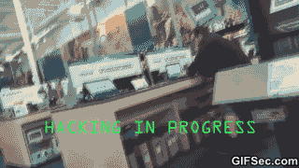
Write Syntax
Now Start Writing Code
Talk It Out (Think out loud)
Don’t Be Afraid To Make Mistakes
Don’t Get Caught Up On Syntax
Write Clearly and Slowly

Slide 20
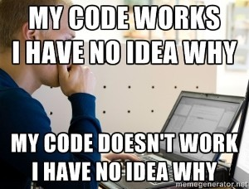
Test
Step Through Your Code (Out Loud)
Track Your Variables
Test Edge Cases
Shows thoroughness

Slide 21
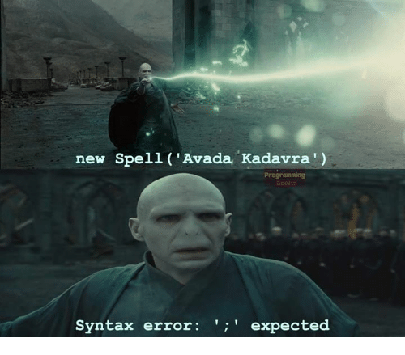
Make Changes
Fix Any “bugs” or missed branches
Discuss Improvements & Enhancements

Slide 22
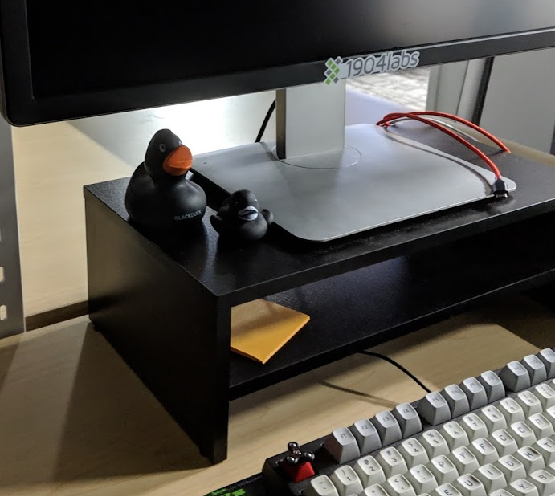
Practice Makes Perfect
https://www.hackerrank.com/
https://leetcode.com/
http://exercism.io/
https://checkio.org/
https://codesignal.com/
Notes:
These websites have all types of questions you can run through and practice from many different tech companies.

Slide 23
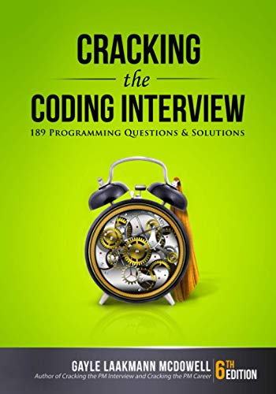
Buy this book!
Buy “Cracking the Coding Interview”
https://www.amazon.com/Cracking-Coding-Interview-Programming-Questions/dp/0984782850/
Notes:
The book was written by Gayle McDowell who worked and interviewed candidates at at Google, Microsoft, and Apple.
This book has 189 programming interview questions asked by big tech company's like Google, Meta, Microsoft, Amazon, and Apple.
It has hints that interviewers might give you when stuck on a problem and it has the solutions in Java so we all can understand them.

Slide 24
Demo - Live Coding

Slide 25
Coding challenge
https://www.coderbyte.com/editor/Longest%20Word:JavaScript
“First, solve the problem. Then, write the code.” – John Johnson

Slide 26
Activity: Standup
I’m sure some of you have already been doing this but if not …
Be able to answer and tell your team
What have you done from last sync?
What are you going to do until the next sync?
Are you block by anything or need any help with stuff?
Notes:
During Standup it helps to take mental notes of what other team members are doing or problems they are having because you might run into the same problems and learn who to ask for help :D

Slide 27
Activity & Assignment: Project Review
Spend 15-20 mins with your mentor reviewing work that have been completed up until now.
Should be able to answer
What stories have you been working on recently?
What code design decisions did you make and why?
For instance, How did you design your model class and controllers?
What has been the most challenging aspect of your project so far?
Did you overcome it? If so, how?
What are you going to be working on next?
Notes:
During Standup it helps to take mental notes of what other team members are doing or problems they are having because you might run into the same problems and learn who to ask for help :D

Slide 28
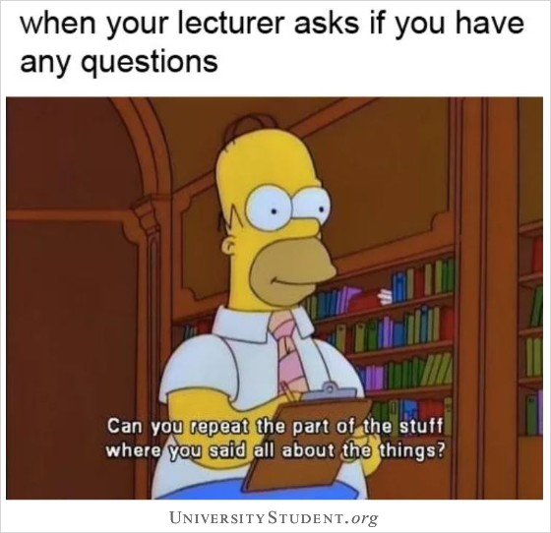
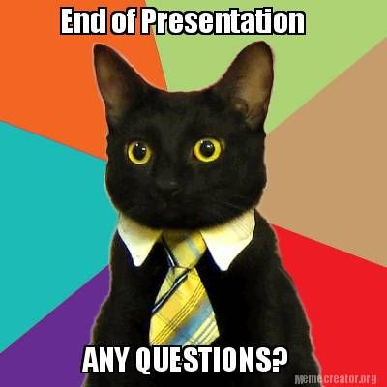
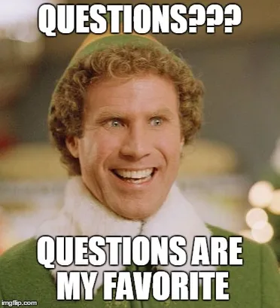
QuEsTiOnS
??????
QuEsTiOnS

